Slide 1
IoT Protocols
MQTT
AMQP
CoAP
HTTP
WebSockets
STOMP
Sockets (own)

Slide 2
Overall Informations
Tests made with USB to Ethernet adapter: 2 extra bytes (only seen in receiving packets)
Publish topic only 1 of 3 used: 50 extra bytes
vat_test_setup/PRODTOOL/MODULE_ID/PROD_ID/BASIC/v1
All tests and results are implemented to match the RabbitMQ specifications, to get easy access to the CrateDB (except WebSockets)
Send only 1 set of payload
Plain (~140 byte): {\n"ts": 1542384113143,\n"tsi": 456,\n"id": "234234958475",\n"temp1": 20.5,\n"temp2": 25.3,\n"accelx": 3.4,\n"accely": 3.4,\n"accelz": 3.4\n}
Binary (38 byte): 2 long (8 byte), 1 short (2 byte), 5 float (4 byte)

Slide 3
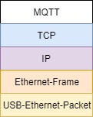
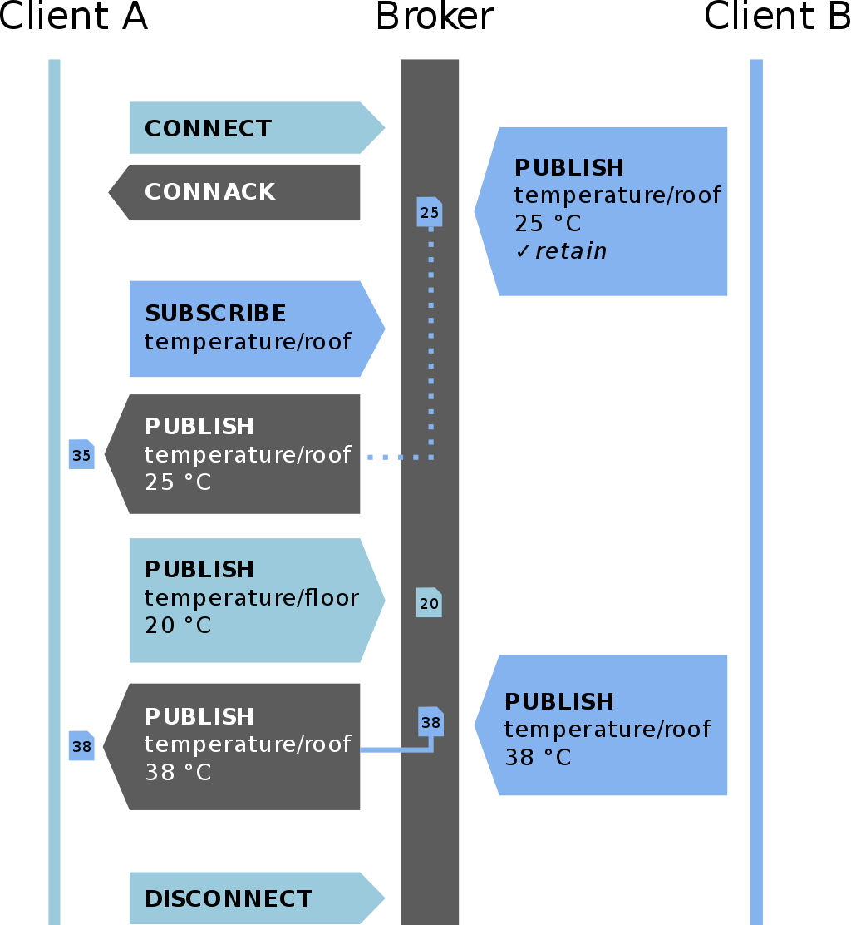
MQTT
Message Queuing Telemetry Transport
Publish-subscribe-based
Requires message broker (e.g. RabbitMQ)
3 different QoS
QoS 0: fire and forget
QoS 1: re-tried until ACK received
QoS 2: exactly once
Last Will
Also 3 QoS

Slide 4
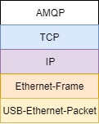
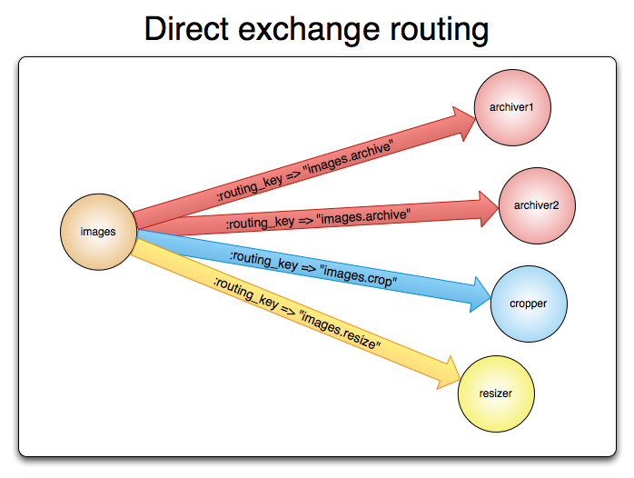
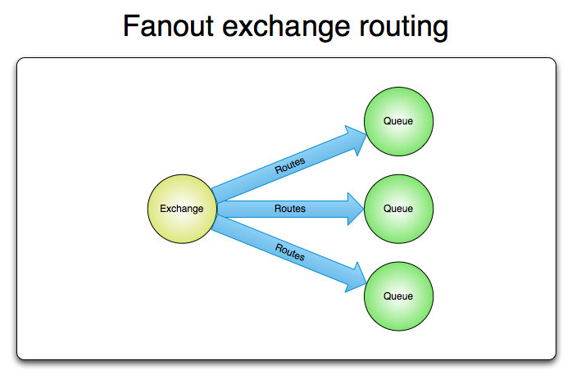
AMQP
Advanced Message Queuing Protocol
The main protocol for RabbitMQ
queuing & routing (point 2 point, publish/subscribe)
More possibilities and way more overhead than MQTT
Fanout, direct, topic …
Due to complexity of the protocol not longer investigated

Slide 5
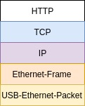
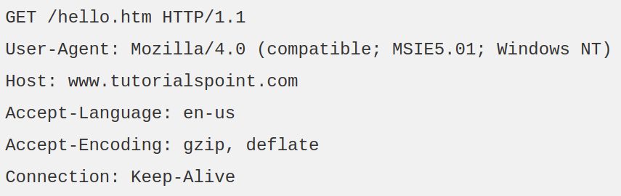
HTTP 1.1
HyperText Transfer Protocol
Plaintext / humanreadable
Request/response model
RabbitMQ plugin available
Reliable through TCP
Lots of overhead

Slide 6
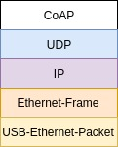
CoAP
Constrained Application Protocol
HTTP in binary
Uses UDP (about 20 bytes less than TCP)
RabbitMQ plugin (only 3.6)
Reliability implemented in CoAP
Easy to convert CoAP to HTTP
Observable (like publish / subscribe)

Slide 7
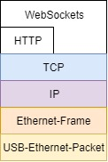
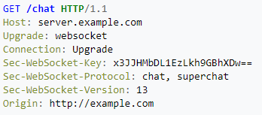
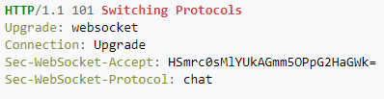
WebSockets
Full-duplex communication over single TCP connection
Handshake uses HTTP Upgrade header
Own server (or service) needed
Additional parser to match RabbitMQ needed

Slide 8
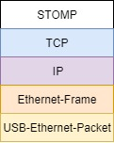
STOMP
Streaming (or Simple) Text Oriented Messaging Protocol
Plain text
Similar to HTTP, but less overhead
RabbitMQ plugin available
(also available as WebSTOMP, only with Javascript)

Slide 9
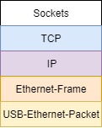
Sockets
Internal endpoint for sending or receiving data
Can build own protocol
Own Server and Parser needed
Send only important data
Own implementation:
1 Statusbyte
Send topic with connect, not with publish
Implemented like MQTT QoS 1

Slide 10
Results

Slide 11
Results cont.

